Slide 1
Structures
Lecture 5

Slide 2
Structures (a record)
A structure is a user defined heterogeneous data structure; e.g.
struct personnel /* Structure template for employee */
{
int number;
char surname[26];
char initial;
char dob [8];
int dept;
char date_joined [8];
}; typedef struct personnel Personnel
// declare a variable for a structure
Personnel person;

Slide 3
Nested structures and pointers
struct date /* Structure template for a date */
{
int day;
int month;
int year;
};
struct personnel /* Structure template for employee */
{
int number;
char surname[26];
char initial;
struct date dob;
int dept;
struct date joined;
}; typedef struct personnel as Personnel
Personnel person; // declaring a variable to a structure
Personnel *ptr; //declaring a pointer to a structure

Slide 4
Using structure
The following are examples of accessing fields
Using the (dot) . operator
person.surname // it’s a string (a primary field)
person.dob.day // a field of a nested structure
person.dept
Using pointer notations ( ->)
ptr = &person // assign struct to a pointer
ptr -> surname;
ptr ->dob.day;

Slide 5
Passing a structure to a function
Like other data types a structure can be passed by value or by reference.
By value “ pass the structure” and by reference “a pointer to the structure”.
Do not forget to use the appropriate notation in each function (if struct use the dot operator; if pointer to struct use the ->

Slide 6
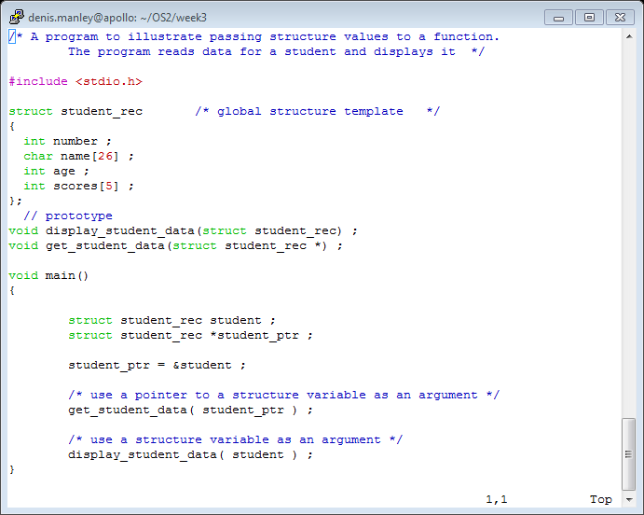
Passing structures to functions

Slide 7
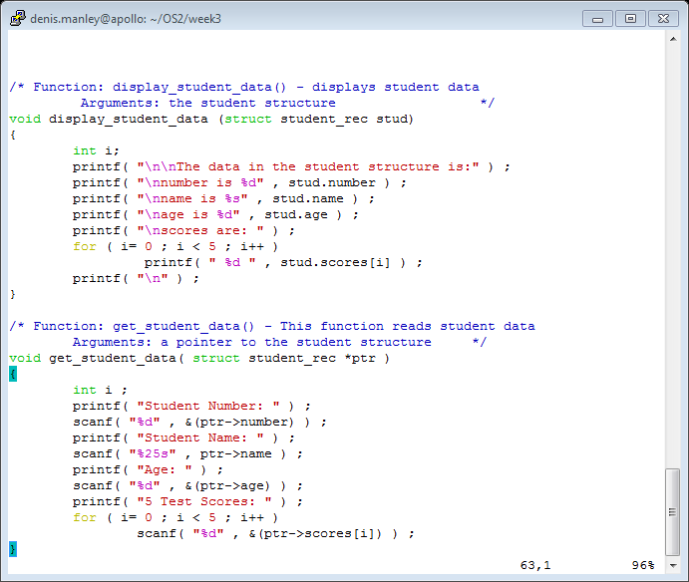
Display and Get functions

Slide 8
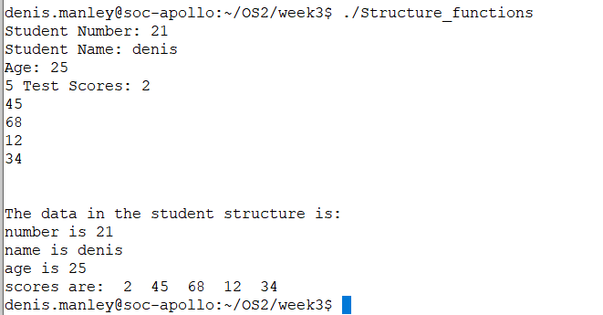
Sample output

Slide 9
Array of structure
An array can also hold structures
Typedef
Typedef struct personnel EMPLOYEE
Declare an array of structures
EMPLOYEE staff[20];
The empdb.c is a program that declares an array of structures and then allows the user to
Add a record to array of structures
Delete a record
Display a record
Edit a record
Implementation: Empty position in array denoted by number field contain 0

Slide 10
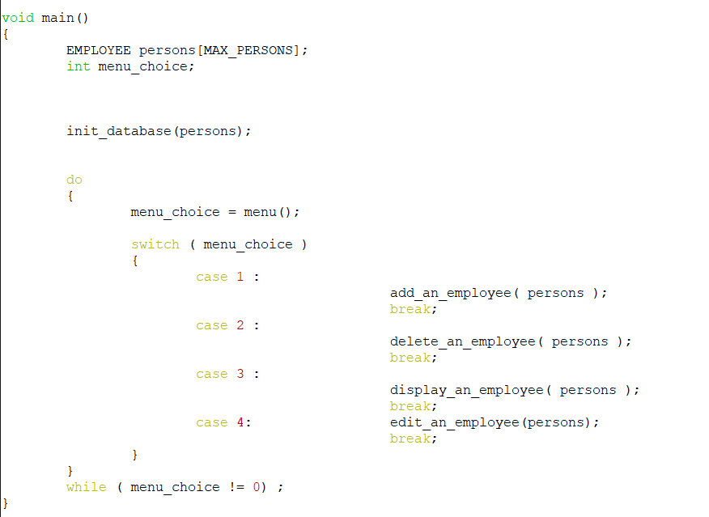
Emp.c Main functions

Slide 11
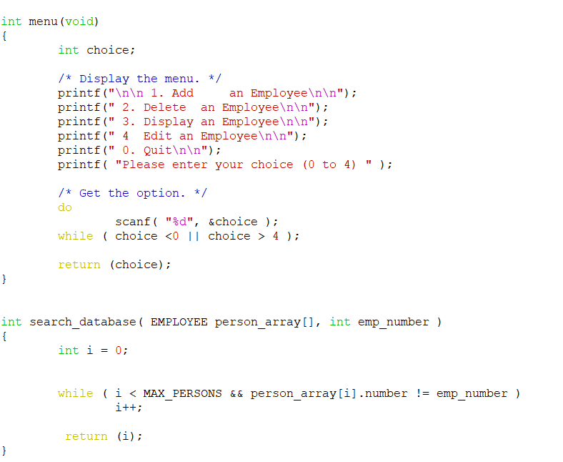
Menu and search functions

Slide 12
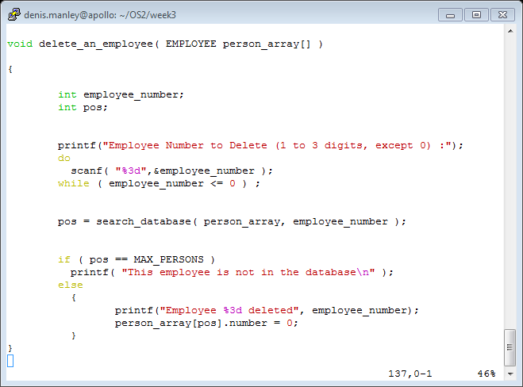
Delete Function (assign 0 to number field)

Slide 13
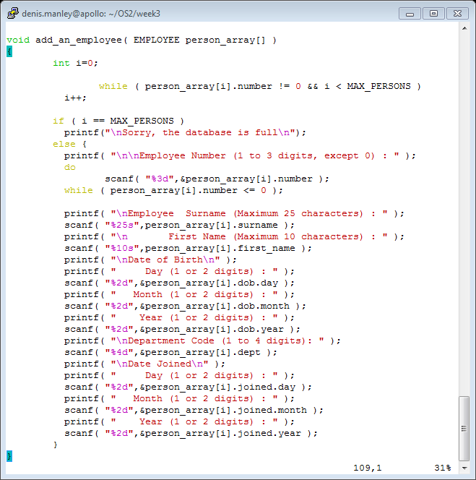
The add function
Why is there no & for scanf(“s”,….)?

Slide 14
Home work
Modify the empdb.c source code:
To include a function to edit a record the array of structures.
ask the user for a record number;
If the position exists: modify the contents
you can simply prompt the user to re-enter all the data again
Test the modified source code to confirm it does as expected: Use specific examples

